Slide 1
Training on ML
AI/ML Basics
Hands-on

Slide 2

What is Artificial Intelligence?

Slide 3
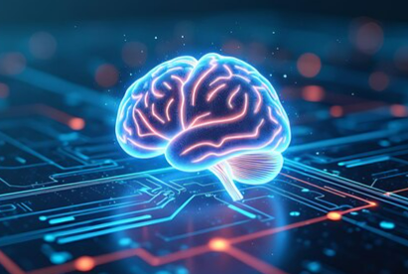
AI is like giving computers a brain! They can talk, play games, and even drive cars!
AI Types: Narrow AI (e.g., chatbots) vs. General AI (future goal).
How? Algorithms + Data → Decisions.
3

Slide 4

Types of AI
Narrow AI (Weak AI)
Definition: AI designed for a specific task.
Examples:
Siri, Alexa
ChatGPT
Recommendation systems
General AI
Definition: AI with human-level cognitive ability; can perform any intellectual task that a human can.
4

Slide 5
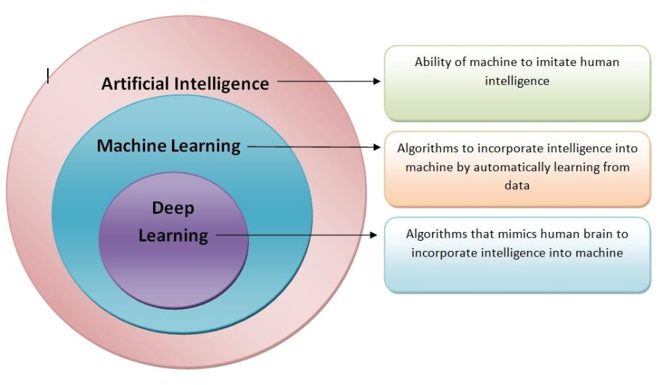

Slide 6
What is Machine Learning?
Machine Learning is a technique where computers learn patterns from data instead of being explicitly programmed.
It improves automatically through experience.

Slide 7
Types of Machine Learning
Supervised Learning → With labels
Unsupervised Learning → Without labels
Reinforcement Learning → Based on rewards

Slide 8
Supervised Learning
Model is trained with input and correct output (labels).
Learns to map input to output.
Example 1: Predict house price using features like area, location, and number of rooms.
Example 2: Classify emails as Spam or Not Spam.

Slide 9
Supervised Algorithms
Regression (Continuous values)
Linear Regression, Decision Tree Regressor
Example: Predict ice cream sales or temperature.
Classification (Categories)
Logistic Regression, Decision Tree Classifier, k-NN
Example: Predict if a student will pass/fail based on hours studied.

Slide 10
Supervised Learning Use Case
Scenario: Predicting Ice Cream Sales
Inputs: Temperature (°C)
Output: Ice Cream Sales (litre's of ice cream sold)
Why supervised? → Because the ice cream sales (label) is already known for the training data. We use this known data to train the model and predict future sales based on temperature.

Slide 11
Hands-on Preview
Supervised: Ice cream sales prediction with Linear Regression

Slide 12
Unsupervised Learning
No labeled data.
The algorithm finds patterns, structures, or groupings in data.
Example : Group customers based on their spending habits.

Slide 13
Unsupervised Algorithms
Clustering:
Groups similar data points into clusters.
K-Means, DBSCAN, Hierarchical Clustering
Example: Group mall customers into clusters like “High Spender” or “Budget Buyer”
Dimensionality Reduction:
Reduces the number of features in dataset while preserving most important characteristics.
PCA, t-SNE
Example: Visualizing high-dimensional data in 2D

Slide 14
Unsupervised Learning Use Case
Scenario: Customer Segmentation
Inputs: Annual Income, Spending Score
No labels available.
Why unsupervised? → No predefined groups. The algorithm creates clusters like:
Group 1: High Income, High Spend
Group 2: Low Income, Low Spend

Slide 15
Hands-on Preview
Unsupervised: Mall Customers dataset with K-Means Clustering

Slide 16
Machine Learning Workflow
Data Collection
Data Cleaning
Feature Engineering
Model Training
Model Evaluation
Model Deployment
Example: For an Ice Cream sales prediction model:
Collect past sales data.
Clean missing entries.
Train a regression model.
Evaluate using RMSE.
Deploy API to production.

Slide 17
Quiz Time!
What’s the main difference between supervised and unsupervised learning?
a) Supervised uses labeled data
b) Supervised uses clustering
c) Unsupervised uses labels
d) None of the above
Ans:

Slide 18
Quiz Time!
Which algorithm is used for classification?
a) Linear Regression
b) Logistic Regression
c) K-Means
d) PCA
Ans:

Slide 19
Quiz Time!
Which of these is a clustering algorithm?
a) Decision Tree
b) Logistic Regression
c) K-Means
d) Random Forest
Ans:

Slide 20
Thank You
Yogeshkumar R
yogeshkumarr@virtusa.com

